Slide 1

CHAPTER TWO
Factors in Developing Mobile Applications
By: Behayilu M.
Faculty of Computing and Software Engineering(FCSE),
Arba Minch Institute of Technology(AMiT),
Arba Minch University

Slide 2
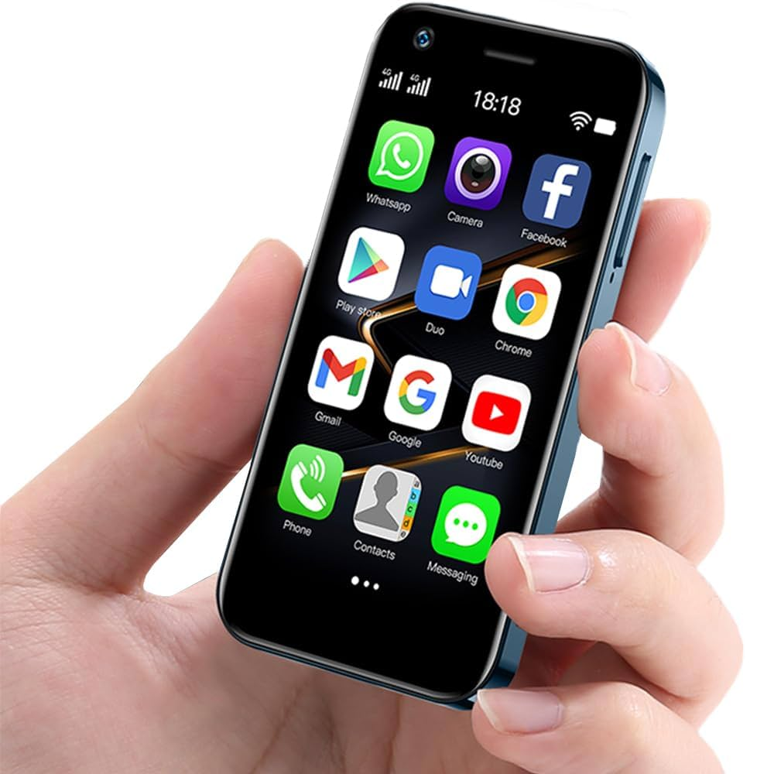
CONTENTS
Understand mobile software engineering
Types of mobile apps and factors
Understand mobile frameworks and tools
Develop mobile generic UI
Understand types of UI

Slide 3
Mobile Software Engineering
It is a specialized field of SE that focuses on the design, development, and maintenance of software applications for mobile devices, such as smartphones and tablets.
Key aspects of mobile SE
Platform-specific dev’t
Cross-platform dev’t
UI and UX design
Performance Optimization
Mobile specific features
Security and Protection
Testing and debugging
App distribution and maintenance

Slide 4
key aspects of mobile software engineering
Aspect | Description
Requirements Analysis | Identify user needs, app goals, and target platforms.
UX/UI Design | Create user-friendly, responsive, and visually appealing interfaces.
Platform Selection | Choose between native, cross-platform, or hybrid development approaches.
Development & Coding | Write efficient, modular code; integrate APIs; manage device resources.
Testing & Quality Assurance | Perform functional, performance, and device compatibility tests.
Security | Protect data, ensure safe authentication, and prevent vulnerabilities.
Performance Optimization | Optimize memory, speed, battery use, and app size.
Deployment & Distribution | Publish apps on stores; manage signing, versioning, and guidelines.
Maintenance & Updates | Fix bugs, update features, and ensure compatibility with new OS versions.
Project Management & Collaboration | Use Agile/Scrum methods and tools for teamwork and progress tracking.

Slide 5
Types of Mobile Apps and Factors
Factors | Native | Hybrid | Web
Performance | High | Moderate | Low
Cost | High | Moderate | Low
Time to Market | Long | Moderate | Fast
Device Features | Full Access | Partial Access | Limited Access
User Experience(UX) | Best | Good | Basic
Offline Support | Full | Partial | None
Maintenance | Difficult | Moderate | Easy
App Store Distribution | Required | Required | Not Required

Slide 6
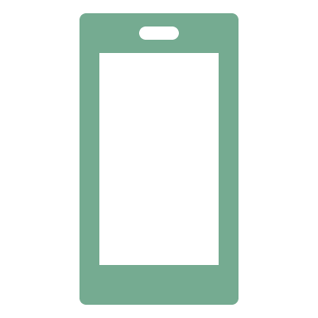

Frameworks and Tools
In general, the basic method of creating an Android app is to use Android
Studio.
However, there are many other Android Development Frameworks that are quite popular in and to provide you a little variety, the list is given below…

Slide 7
1. Ionic
Ionic framework is a very popular open-source mobile framework that was released in 2013.
Uses web technologies (HTML,CSS, and JS) to build beautiful cross-platform mobile apps.
Ionic has documentation support with real-life examples
Focuses on the frontend UX and UI interaction of an app
It's easy to learn, and integrates with other libraries or frame works, such as Angular, React, or Vue.

Slide 8
2. Xamarin
Xamarin is an extremely popular Mobile framework that was acquired by Microsoft in 2016 and is currently a Microsoft subsidiary.
So basically, Xamarin can be used to write native Android, iOS and Windows apps with a C# codebase that can also be shared across multiple platforms.
Xamarin is also popular IDE with Microsoft Visual Studio and can be used to create native apps.
Lets you build native apps for Android, iOS, and macOS using .NET code and platform-specific user interfaces.
Xamarin Forms allows you to build native apps, with shared UI code written in C# or XAML.

Slide 9
3. Adobe PhoneGap
Adobe PhoneGap is an open-source mobile application development framework that was purchased by Adobe Systems in 2011.
Its unique feature is that it can be used to build mobile applications using HTML5, CSS3, and JavaScript instead of using API like Android, iOS, or Windows Phone.
According to PhoneGap, it can be used to “Reuse existing web development skills to quickly make hybrid applications built with HTML, CSS, and JavaScript.”

Slide 10
4. React Native
React Native is an open-source JavaScript codebase mobile framework that was created by Facebook and released in 2015.
Allows developers to use same codebase for both iOS and Android applications. It offers hot reloading feature – which allows developers to see changes to app in real time as they make them.
It provides support for various IDEs and mobile app development tools and that is one of the main reasons it is used by many companies such as Instagram, Tesla, Walmart, Baidu, etc. to develop their mobile apps.

Slide 11
5. Flutter
Flutter is a comparatively recent open-source development framework that was released by Google in 2017.
Enables developers to build beautiful cross-platform mobile apps.
It also offers hot reloading feature – which allows developers to see changes to app in real time as they make them.
Flutter is written in the Dart programming language and it is currently used by famous companies such as Alibaba, Tencent, Google.

Slide 12
6. Titanium SDK
Titanium SDK is an open-source software development kit (SDK) framework that allows developers to build mobile applications for Android, IO, and Windows using JavaScript instead of native programming languages like Java, Swift, or Kotlin.
Titanium SDK is was created by Appcelerator, Inc. and released in 2018.
It is basically a development environment that can be used to create native apps across various operating systems like iOS, Android, BlackBerry, using JavaScript.
It offers wide range of APIs and pre-built modules that can be used to add functionality to the app.

Slide 13
7. JQuery Mobile
jQuery Mobile is a Touch-Optimized UI Framework that was developed by the jQuery team and released in 2010.
Built on top of the jQuery library, a popular JavaScript library for web development.
It is based on HTML5 and can be used to create responsive web sites and apps that can be accessed using multiple devices such as smartphones, tablets, desktops, etc.
It focuses on providing a consistent look and feel across devises, easy navigation and built in themes and UI components.
According to the jQuery team, this takes the “write less, do more” mantra to the next level!!!

Slide 14
8. Corona SDK – now Solar2D
Corona Software Development Kit was developed by Corona Labs Inc. and released in 2009.
Allows developers to create mobile apps and games for iOS and, Android using Lua programming language.
It is easy to use and quick for development time.
In 2020, Corona SDK was renamed Solar2D after it became fully open source.

Slide 15
9. Swift
Swift is a general-purpose, compiled programming language introduced by apple in 2014 for building apps on iOS, macOS, watchOS, tvOS, and even Linux.
It is used to build native iOS apps.
It offers a simple and easy to use syntax and supports a wide range of iOS frameworks and APIs.

Slide 16
10. Java
Popular programming language created by Sun microsystems, now acquired by Oracle.
Used to build native Android apps.
Offers a wide range of libraries and frameworks that can be used to build native android apps.

Slide 17
Summary of Frameworks
Framework | Languages | Example App | Is it Free? | To start
IONIC | HTML,CSS,JS | Sworkit | Yes | Get npm 1st
XAMARIN | C#,.NET | Storyo | Xamarin.Forms | Check the website
Adobe Phone Gap | HTML, CSS, JS | Wikipedia | Yes | Get npm 1st
Flutter | Dart | Google Ads | Yes | Get flutter sdk
Corona SDK/Solar2D | Lua scripting | Corona Geek | Corona Simulator | Check the website
Titanium SDK | Js,XML, Alloy | iComics | Yes | Get npm 1st
JQuery Mobile | HTML,CSS,JS,Jquery Ajax | Bank of America | Yes | Get npm 1st
React Native | JS | Instagram | Yes | Get npm 1st

Slide 18
Generic UI Development
Refers to the process of creating user interfaces (UI) that are flexible and can be used across multiple platforms and devices.
This approach allows developers to create a single UI design that can be adapted for use on different screen sizes and resolutions.
Techniques used in generic UI development
  Responsive design – flexible/auto adjusting design
  Modular design – break down the UI into smaller and reusable components
  Design patterns – using pre-built UI components
  Standardization – being consistent in using UI elements and design
  Accessibility – consider the disabled group
Notes:
https://medium.com/mindorks/android-ui-ux-tips-tricks-f7f838dac92f

Slide 19

Android User
Android users are those who use mobile devices that run on the Android operating system, such as smartphones, tablets, or wearable devices
Consider the following for an android user during development:
  Understand android platform
  Use a user centric approach during UX design
  Optimize app performance
  Test and debug app
  Ensure security of app

Slide 20
VUI – voice user interface
VUI is a type of interface that allows users to interact with a device or application using voice commands.
VUIs are commonly used in devices like smart speakers or in-car navigation systems.
VUIs are designed to be hands-free and can be useful in situations where a user's hands are occupied, such as cooking or driving.
An example of an application that uses both VUI and mobile app interfaces is the Amazon Alexa app.
The Amazon Alexa app is a mobile app that allows users to control and customize their Amazon Alexa-enabled devices, such as the Amazon Echo or Echo Dot.

Slide 21
Text to Speech
Text-to-Speech (TTS) is a technology that allows mobile apps to convert written text into spoken words.
TTS can be used to create a VUI (Voice User Interface) for mobile apps, allowing users to interact with an app using voice commands.
Techniques:
  Platform-specific APIs e.g. Android provides TextToSpeech API
  Cloud-based TTS e.g. Google Cloud Text-to-Speech , Amazon Polly
  Custom TTS Engines e.g. use open source libraries like MaryTTS or eSpeak
  Pre-recorded Audio e.g. requires high storage space

Slide 22
Designing the right UI
Tips for designing the right UI:
  Know your audience
  Keep it simple
  Use visual hierarchy
  Use appropriate color schemes
  Use appropriate typography
  Use responsive design
  Test and iterate

Slide 23
Multichannel UI and Multimodal UI
Multichannel UI
  refers to an interface that allows users to interact with an app using multiple channels or modes, such as touch, voice, or gestures.
  For example, a mobile app might allow users to interact with the app using touch-based inputs, voice commands, or camera-based gestures.
  Multichannel UI can be useful for users with different preferences or for situations where a user's hands are occupied.
  Example : A mobile app for cooking might allow users to interact with the app using both touch-based inputs and voice commands.

Slide 24
...cont’d
Multimodal UI
  Refers to an interface that allows users to interact with an app using multiple modes simultaneously.
  For example, a mobile app might allow users to interact with the app using both touch-based inputs and voice commands at the same time.
  Multimodal UI can be useful for creating a more natural and intuitive user experience.
  A mobile app for exercise might allow users to interact with the app using both touch-based inputs and camera-based gestures

Slide 25
Reading Assignment
Explore the frameworks used for mobile application development in 2023 and submit a report of it.
What is the Android API level? Explain the different versions of Android too .
Perform a comparative analysis of the software tools/IDE used to develop mobile applications and report the strengths and weaknesses of each tool.
What is the best practice for executing/running android applications? Report your findings by describing the strength and weakness of each.

Slide 26
≈∕∕≈

